Slide 1
IGCSE CS Database
By Fatma AlZahraa Bakr
Mariam Amir

Slide 2
Aim Of Database
The database design will be used to help an IGCSE teacher to maintain the data of his students and their attendance throughout the year.

Slide 3
Some Business Rules
01
Employees
02
Salary
03
Students
04
Groups
An employee can be an assistant or a grader but can’t be both and is assigned to many students.
For employees, Salary history has to be maintained.
Attendance must be tracked.
There are 3 sessions every week for each group (Class1, Class2, Quiz)

Slide 4
01
Schema

Slide 5
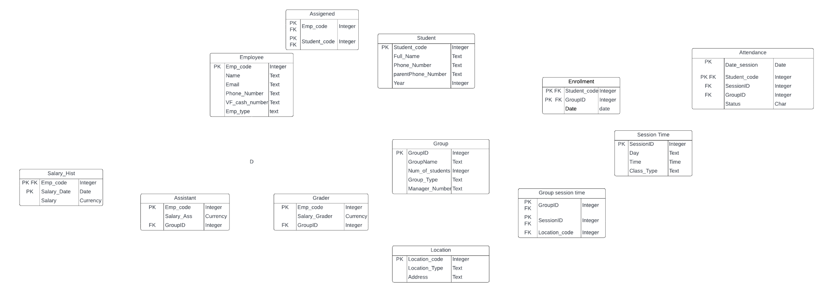

Slide 6
Part 1

Slide 7

Part 2
Explanation
Many to Many, Joint table was used

Slide 8
Part 3
Explanation
Each Group have one or many grader but each grader is only in one group
Each Group have one or many assistant but each assistant is only in one group

Slide 9
Part 4
Explanation
Student - Group (Many to Many)
Enrollment Is a joint Table
Group-Session time (Many to Many)
Group Session Time Is Joint Table
Justification for the zero in the relationship between students- Attendance ( He may not be added to attendance table yet , he must at least attend 1 session to be added)

Slide 10
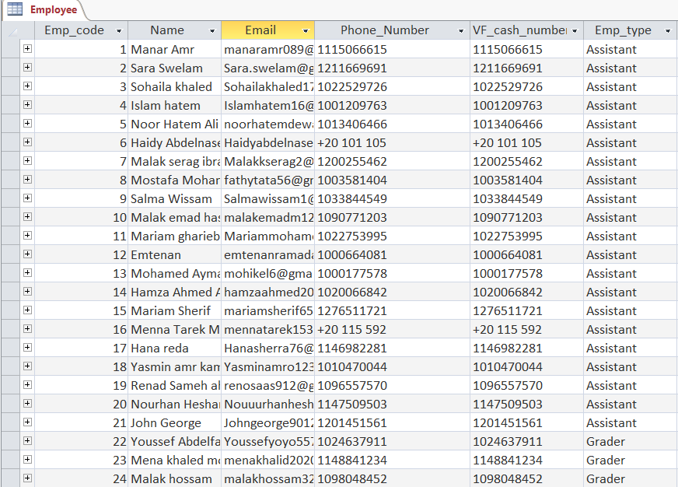
Create Table Example
Code
Insert
Output
CREATE TABLE `Employee` (
`Emp_code` Integer,
`Name` Text NOT NULL,
`Email` Text NOT NULL,
`Phone_Number` Text(12) NOT NULL,
`VF_cash_number` Text(12) NOT NULL,
`Emp_type` text NOT NULL,
PRIMARY KEY (`Emp_code`)
);
INSERT INTO Employee
VALUES(1, ‘Manar Amr’, manaramr089@gmail.com, 1115066615, 1115066615, Assistant);

Slide 11
02
Queries

Slide 12
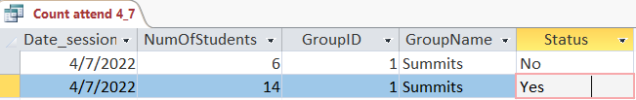
Count attendance 4/7
Code
Output
SELECT [Attendance ].Date_session, Count([Attendance ].Student_code) AS NumOfStudents, [Attendance ].GroupID, Group.GroupName, [Attendance ].Status
FROM [Attendance ] INNER JOIN [Group] ON [Attendance ].GroupID = Group.GroupID
GROUP BY [Attendance ].Date_session, [Attendance ].GroupID, Group.GroupName, [Attendance ].Status
HAVING ((([Attendance ].Date_session)=#4/7/2022#) AND (([Attendance ].GroupID)=1));

Slide 13
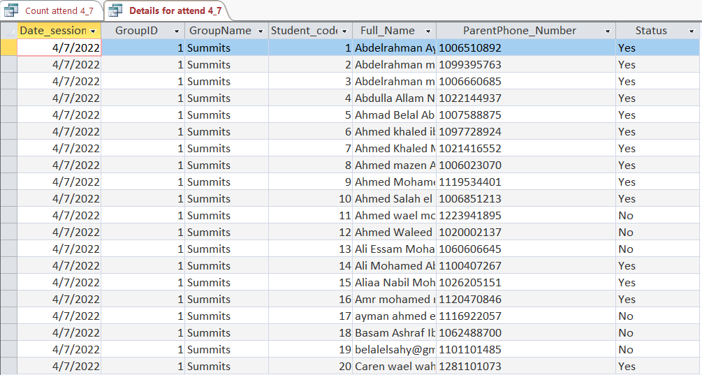
Details attendance 4/7
Code
Output
SELECT [Attendance ].Date_session, [Attendance ].GroupID, Group.GroupName, [Attendance ].Student_code, Student.Full_Name, Student.ParentPhone_Number, [Attendance ].Status
FROM Student INNER JOIN ([Attendance ] INNER JOIN [Group] ON [Attendance ].GroupID = Group.GroupID) ON Student.Student_code = [Attendance ].Student_code
GROUP BY [Attendance ].Date_session, [Attendance ].GroupID, Group.GroupName, [Attendance ].Student_code, Student.Full_Name, Student.ParentPhone_Number, [Attendance ].Status
HAVING ((([Attendance ].Date_session)=#4/7/2022#) AND (([Attendance ].GroupID)=1));

Slide 14
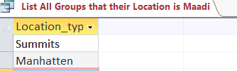
Schools In maadi
Code
Output
SELECT Location_type
FROM Location
WHERE Address='Maadi';

Slide 15
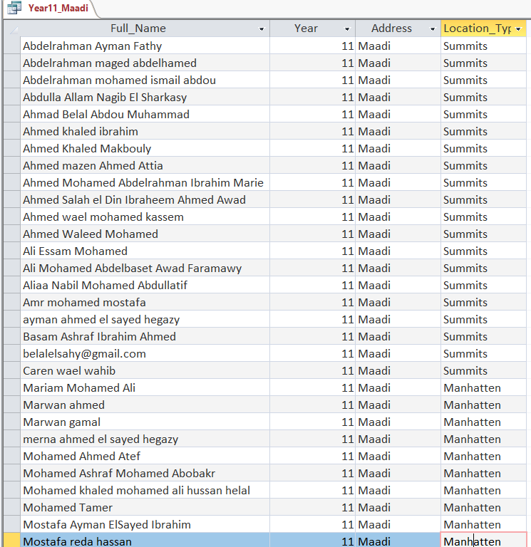
Year 11 Students Maadi
Code
Output
SELECT Student.Full_Name, Student.Year, Location.Address, Location.Location_Type
FROM Student INNER JOIN ((Location INNER JOIN ([Group] INNER JOIN [Group session time] ON Group.GroupID = [Group session time].GroupID) ON Location.Location_code = [Group session time].Location_code) INNER JOIN Enrollment ON Group.GroupID = Enrollment.GroupID) ON Student.Student_code = Enrollment.Student_code
GROUP BY Student.Full_Name, Student.Year, Location.Address, Location.Location_Type
HAVING (((Student.Year)=11) AND ((Location.Address)="Maadi"));

Slide 16
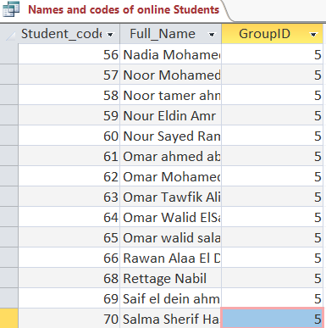
Name and Codes Of Online students
Code
Output
SELECT Student.Student_code, Student.Full_Name, Enrollment.GroupID
FROM [Group] INNER JOIN (Student INNER JOIN Enrollment ON Student.Student_code = Enrollment.Student_code) ON Group.GroupID = Enrollment.GroupID
WHERE (((Enrollment.GroupID)=5));

Slide 17
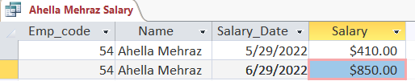
Ahella Salary
Code
Output
SELECT Salary_Hist.Emp_code, Employee.Name, Salary_Hist.Salary_Date, Salary_Hist.Salary
FROM Employee INNER JOIN Salary_Hist ON Employee.Emp_code = Salary_Hist.Emp_code
GROUP BY Salary_Hist.Emp_code, Employee.Name, Salary_Hist.Salary_Date, Salary_Hist.Salary
HAVING (((Employee.Name) Like "*Ahella Mehraz*"));

Slide 18
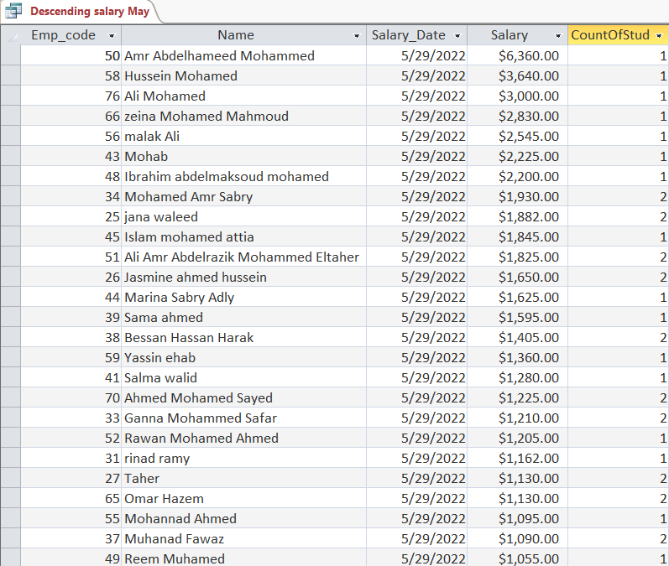
Descending Salary May
Code
Output
SELECT Salary_Hist.Emp_code, Employee.Name, Salary_Hist.Salary_Date, Salary_Hist.Salary, Count([Assigned ].Student_code) AS CountOfStudent_code
FROM (Employee INNER JOIN [Assigned ] ON Employee.Emp_code = [Assigned ].Emp_code) INNER JOIN Salary_Hist ON Employee.Emp_code = Salary_Hist.Emp_code
GROUP BY Salary_Hist.Emp_code, Employee.Name, Salary_Hist.Salary_Date, Salary_Hist.Salary
HAVING (((Salary_Hist.Salary_Date)=#5/29/2022#))
ORDER BY Salary_Hist.Salary DESC;

Slide 19
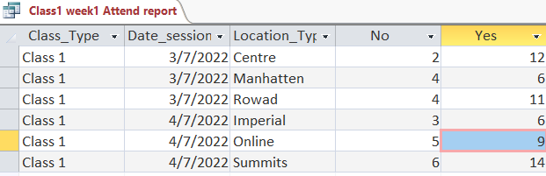
Class 1 w1 Attendance Report
Code
Output
TRANSFORM Count([Attendance ].Status) AS CountOfStatus
SELECT [Session Time ].Class_Type, [Attendance ].Date_session, Location.Location_Type
FROM (Location INNER JOIN ([Session Time ] INNER JOIN [Group session time] ON [Session Time ].[SessionID ] = [Group session time].SessionID) ON Location.Location_code = [Group session time].Location_code) INNER JOIN [Attendance ] ON ([Group session time].SessionID = [Attendance ].SessionID) AND ([Group session time].GroupID = [Attendance ].GroupID)
WHERE ((([Session Time ].Class_Type)="Class 1") AND (([Attendance ].Date_session) Between #3/7/2022# And #9/7/2022#))
GROUP BY [Session Time ].Class_Type, [Attendance ].Date_session, Location.Location_Type
PIVOT [Attendance ].Status;

Slide 20

THANK YOU

Slide 21
03
Rest Of Tables

Slide 22
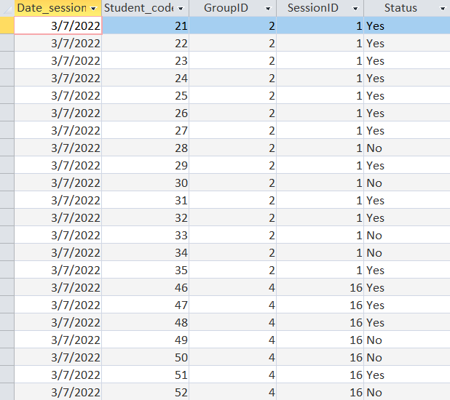
Create Attendance Table
Code
CREATE TABLE `Attendance ` (
`Date_session` Date,
`Student_code` Integer,
`GroupID` Integer,
`SessionID` Integer,
`Status` Char,
PRIMARY KEY (`Date_session`,`Student_code`),
FOREIGN KEY (`Student_code`) REFERENCES `Student`(`Student_code`),
FOREIGN KEY ( `GroupID`,`SessionID`) REFERENCES `Group session time`
);
Output

Slide 23
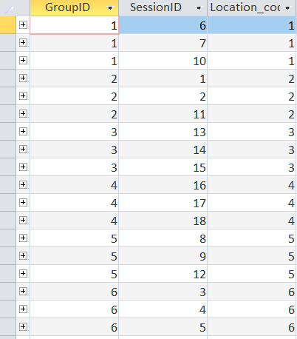
Create Group Session Time Table
Code
CREATE TABLE `Group session time` (
`GroupID` Integer,
`SessionID` Integer,
`Location_code` Integer,
PRIMARY KEY (`GroupID`, `SessionID`),
FOREIGN KEY (`SessionID`) REFERENCES `Session Time `(`SessionID `),
FOREIGN KEY (`GroupID`) REFERENCES `Group`(`GroupID`),
FOREIGN KEY (`Location_code`) REFERENCES `Location`(`Location_code`)
);
Output

Slide 24
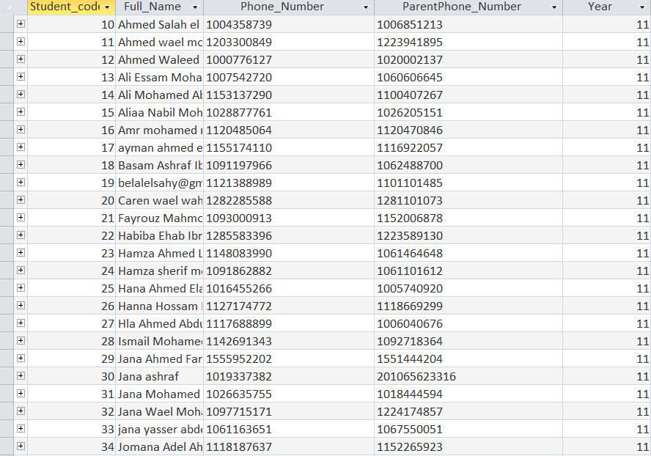
Create Student Table
Code
CREATE TABLE `Student` (
`Student_code` Integer,
`Full_Name` Text NOT NULL,
`Phone_Number` Text(12) NOT NULL,
`ParentPhone_Number` Text(12) NOT NULL,
`Year` Integer NOT NULL,
PRIMARY KEY (`Student_code`)
);
Output

Slide 25
THANK YOU

